Slide 1

Mobile App Development Process (J2EE)
Presentation by Group IV
Course Instructor: Dr. NKEMENI VALERY
Welcome to an in-depth exploration of mobile app development, focusing on key aspects such as types of apps, programming languages, development frameworks, architecture, design patterns, requirement engineering, and cost estimation. This comprehensive overview is designed for university students and faculty, providing a structured approach to understanding the multifaceted world of mobile application creation. We'll examine how different components interact to build efficient, scalable, and user-friendly apps, emphasizing best practices for success.

Slide 2
Comparing Mobile App Types: Native, PWA, and Hybrid
Native Apps
Progressive Web Apps (PWAs)
Hybrid Apps
Optimized for specific operating systems like iOS or Android, offering high performance and seamless integration with device features. Developed using platform-specific languages such as Swift or Java/Kotlin. Example: Google Maps.
Combine native and web elements, using technologies like HTML, CSS, and JavaScript wrapped in a native app shell. Hybrid apps allow cross-platform functionality with a single codebase. Example: Ionic Framework Apps.
Web applications offering a native-app-like experience, installable, and accessible via web browsers. PWAs offer cross-platform compatibility and don't rely on app stores. Example: Pinterest.
Excellent performance
Cross-platform compatibility
Single codebase
Full access to device features
Lower development costs
Access to device features via frameworks
Platform-specific security
No app store dependence
Easier maintenance

Slide 3




Mobile App Programming Languages: Java, Swift, Kotlin, Objective-C
Java
Swift
Kotlin
Objective-C
A widely-used, object-oriented language, is robust with a mature ecosystem, primarily for Android app development. Java ensures high performance via JIT compilation and supports multithreading.
Apple's modern language is for iOS, macOS, watchOS, and tvOS. Emphasizing performance and safety, Swift offers clean syntax and automatic memory management. Actively maintained, it promotes code clarity and reduces memory leaks.
Open-source and statically-typed, Kotlin supports object-oriented and functional programming. Designed to interoperate with Java, Kotlin reduces boilerplate code and minimizes null pointer exceptions, thus improving code quality.
Objective-C uses dynamic runtime and message passing for flexibility, making it highly adaptable for various coding environments. Despite its age, it maintains stability and seamless interaction with C/C++ code.

Slide 4
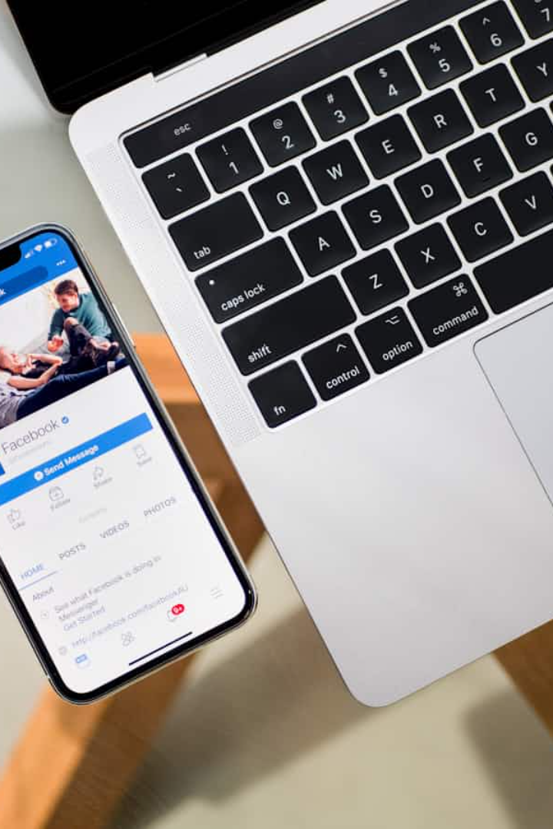
Mobile App Development Frameworks: React Native, Flutter, NativeScript, Ionic, Xamarin
Framework
Language
Performance
Cost & Time to Market
UI & UX
Complexity
React Native
JavaScript
Near-native
Faster development
Customizable
Moderate
Flutter
Dart
High
Fast development
Highly customizable
Steeper learning curve
NativeScript
JavaScript/TypeScript
Native-level
Code reuse
Native UI components
Moderate
Ionic
HTML/CSS/JavaScript
Web-based
Fastest development
Web-based UI
Easiest for web devs
Xamarin
C#
Near-native
Significant code reuse
Native UI or Xamarin.Forms
Moderate

Slide 5
Mobile App Architectures: Monolithic, Layered, Microservices, MVVM
Monolithic Architecture
Layered Architecture
Simple to develop for small projects, with all features in a single unit. However, it becomes difficult to update as the app grows and is not suitable for complex apps.
Divides the application into presentation, business logic, and data layers. It is easier to maintain and update, offering separation of concerns that simplifies debugging but can be more complex than monolithic setups.
Microservices Architecture
MVVM Architecture
The app is divided into small, independent services communicating through APIs. Improved performance and scalable services make it ideal for complex applications.
Separates into Model, View, and ViewModel components, updating product data and reflecting it in the UI in real-time. Easier testing and maintainable code results but implementation can be difficult for beginners.

Slide 6





Mobile App Design Patterns: Singleton, Factory, Observer, Builder, Adapter
Singleton Pattern
Ensures only one instance of a class exists. This saves memory and avoids resource duplication, ideal for weather apps maintaining a single network connection.
Factory Pattern
Creates objects without specifying the exact class, making code more flexible. Best for ride-hailing apps dynamically creating vehicle objects based on user selection.
Observer Pattern
Allows objects to update automatically when changes occur, assisting with real-time updates. Useful in a news app where the UI updates when articles are published.
Builder Pattern
Simplifies creating complex objects step-by-step, which makes code easier to read and manage. Useful in a travel booking app where users select flights, hotels, and rental cars.

Slide 7

Collecting and Analyzing User Requirements for Mobile Apps
Define the Scope
Outline the app's purpose, target users, and key features. Establish clarity among stakeholders.
Gather Requirements
Conduct interviews, surveys, and focus groups to gather feedback and understand user needs. Create use cases.
Analyze and Prioritize
Categorize and prioritize requirements using frameworks like MoSCoW. Visualize requirements with wireframes.
Document
Write a detailed Specification Document (SRS) or Agile user stories. Include clear acceptance criteria.

Slide 8




Documenting and Validating Mobile App Requirements
Validation Sessions
Traceability
Hold regular review sessions with stakeholders to get input and address concerns. Review sessions are crucial for ensuring alignment and addressing issues early on.
Establish traceability between requirements, design, and testing. Traceability ensures the application meets all specified needs effectively.
1
2
Maintain Open Communication
Clear Documentation
Keep stakeholders informed at every stage, ensuring transparency. Maintaining open lines of communication is vital for project success.
4
3
Write clear and concise documentation, avoiding confusion. Clear documentation ensures everyone understands the requirements.

Slide 9
Estimating Mobile App Development Cost: A Structured Approach
Estimating mobile app development costs involves analyzing various influencing factors. The actual cost varies based on complexity, features, and requirements. Start by defining the project scope, including purpose, platforms, and core features.
50-150
30-80
Hourly Rate in North America & Europe (USD)
Hourly Rate in Eastern Europe & South America (USD)
15-50
Hourly Rate in Asia (India, Philippines, etc.) (USD)

Slide 10

Conclusion: Crafting a Budget-Friendly Mobile App Strategy
Mobile app development cost estimation requires planning and consideration of multiple factors. Businesses can create a realistic budget by defining scope, breaking down phases, evaluating integrations, and considering external expenses. Comparing quotes ensures cost-effective decisions while maintaining quality. Long-term support is crucial for post-launch improvements. Keep stakeholders engaged to adapt to changes in user needs and tech. Using tools like Jira and Figma can help streamline your requirements, tracking, and visualization.

